Slide 1

Mechanized Data Consistency Models for Distributed Database Transactions
Shabnam Ghasemirad
Master’s Thesis Presentation
9 November 2022, Information Security Group, ETH Zürich

Slide 2
Table of contents
Preliminaries: Distributed database systems
The operational framework of consistency models
1st verification: 2PL+2PC satisfies serializability
2nd verification: Eiger-PORT+ satisfies causal+ consistency
Conclusions

Slide 3
Preliminaries

Slide 4
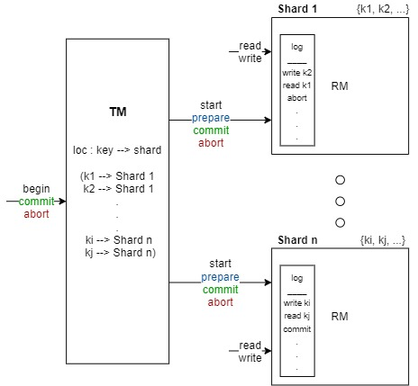
Distributed database systems
Consists of independent components,
spread across different machines or locations.
A common model:
Transaction Manager (TM) and Resource Managers (RM)
TM coordinates (sends commands to) RMs
Each RM has a shard of database or a log
Each RM responsible for a subset of keys
CAP theorem [12]: Distributed database systems can only provide two of the following guarantees:
(strong) Consistency
Availability
Partition tolerance
High scalability and availability → weaker transactional consistency guarantees (consistency models)

Slide 5
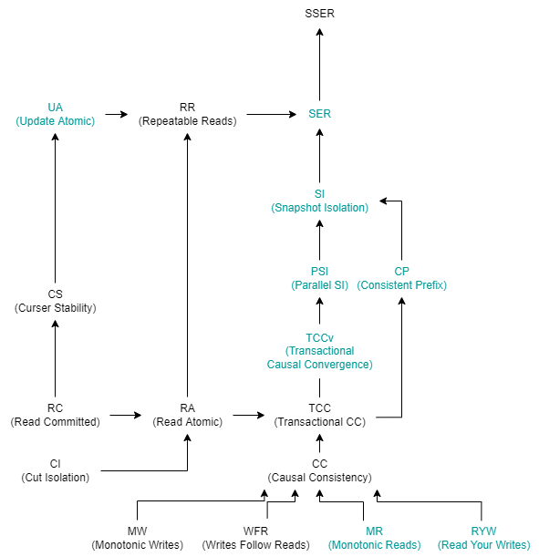
Data consistency models
Definition: A contract between a distributed data store and user processes with certain transactional consistency guarantees.
Some of the most widely used Consistency Models
Read Atomicity
a transaction’s writes become visible atomically
Causal Consistency
Causal relationships between transactions are preserved.
t visible ➔ what t sees also visible.
Parallel Snapshot Isolation
CC + no write conflicts.
(Strict) Serializability
Transactions are totally ordered, mimicking sequential execution.
Notes:
what t observes (read versions, same client)

Slide 6
Data consistency models
Originally defined by engineers and quite informal
General definitions, independent of a particular implementation
Declarative semantics
dependency graphs [8]
abstract executions [9]
Operational semantics: Xiong et al. [10] → centralized model: key-value store
General semantics for weak consistency models
Verify reference implementations
Analyse the behavior of client programs with respect to a particular consistency model

Slide 7
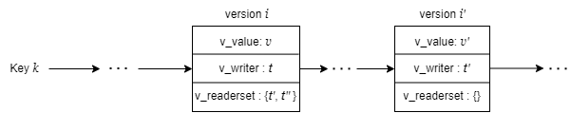
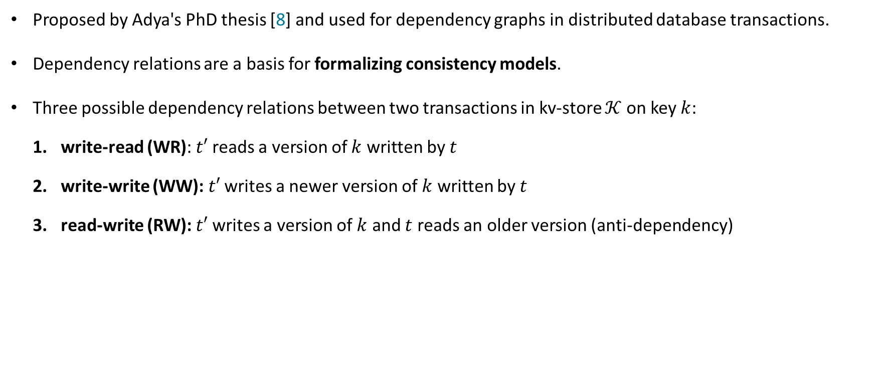



Dependency relations
Proposed by Adya's PhD thesis [8] and used for dependency graphs in distributed database transactions.
Dependency relations are a basis for formalizing consistency models.
Three possible dependency relations between two transactions in kv-store $𝒦$ on key $k$:
write-read (WR): $t′$ reads a version of $k$ written by $t$
write-write (WW): $t′$ writes a newer version of $k$ written by $t$
read-write (RW): $t′$ writes a version of $k$ and $t$ reads an older version (anti-dependency)
$$WW_{𝒦}$$
$$WR_{𝒦}$$
$$RW_{𝒦}$$

Slide 8
The operational framework of
consistency models

Slide 9

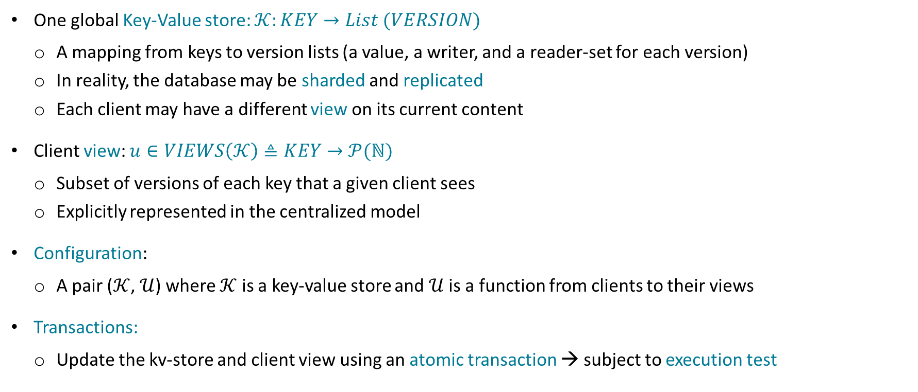
Centralized Operational Semantics
version
One global Key-Value store: $𝒦:KEY→List (VERSION)$
A mapping from keys to version lists (a value, a writer, and a reader-set for each version)
In reality, the database may be sharded and replicated
Each client may have a different view on its current content
Client view: $u∈VIEWS\left(𝒦\right)≜KEY→𝒫(ℕ)$
Subset of versions of each key that a given client sees
Explicitly represented in the centralized model
Configuration:
A pair ($𝒦$, $𝒰$) where $𝒦$ is a key-value store and $𝒰$ is a function from clients to their views
Transactions:
Update the kv-store and client view using an atomic transaction → subject to execution test

Slide 10
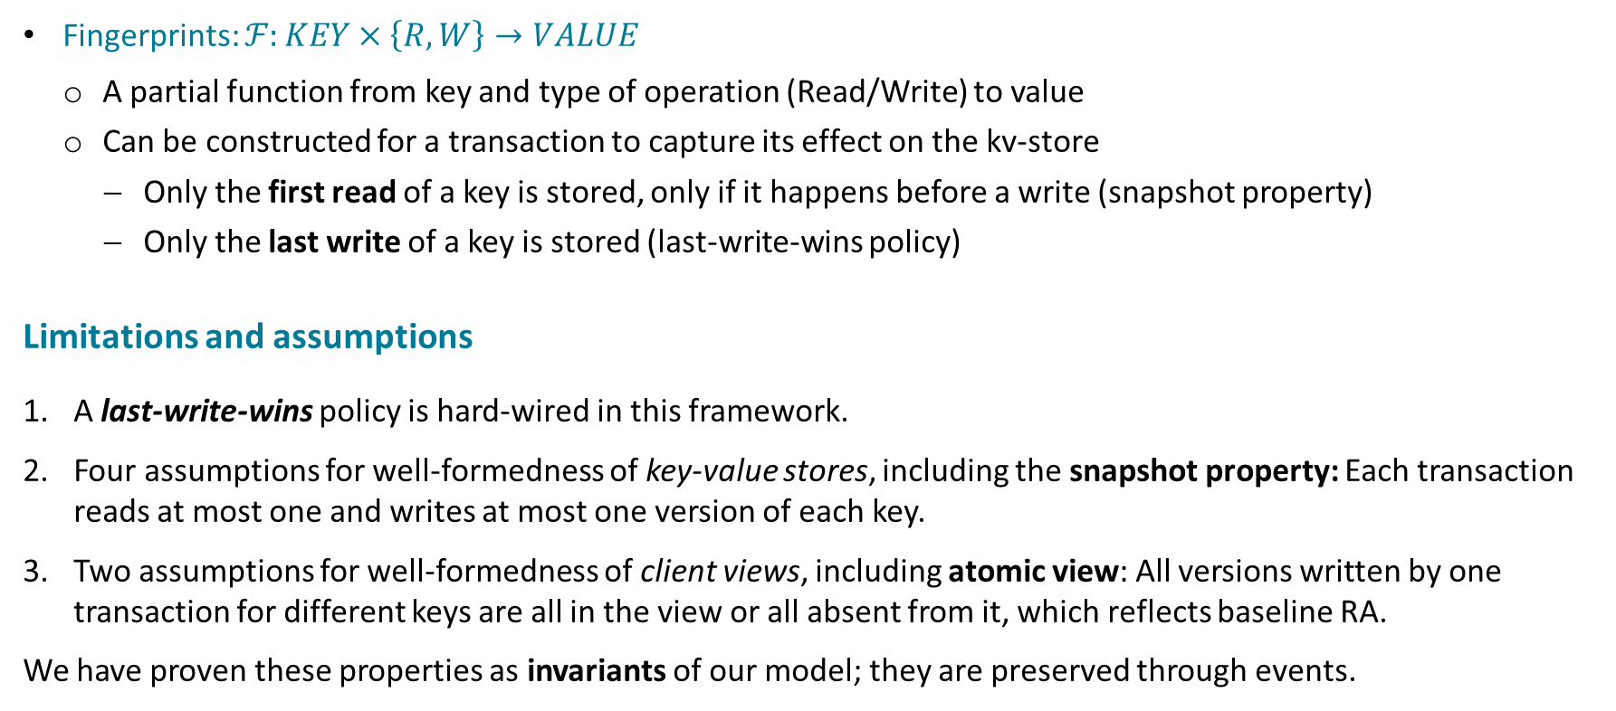
Centralized Operational Semantics
Fingerprints: $ℱ:KEY×\left\{R, W\right\}→VALUE$
A partial function from key and type of operation (Read/Write) to value
Can be constructed for a transaction to capture its effect on the kv-store
Only the first read of a key is stored, only if it happens before a write (snapshot property)
Only the last write of a key is stored (last-write-wins policy)
Limitations and assumptions
A last-write-wins policy is hard-wired in this framework.
Four assumptions for well-formedness of key-value stores, including the snapshot property: Each transaction reads at most one and writes at most one version of each key.
Two assumptions for well-formedness of client views, including atomic view: All versions written by one transaction for different keys are all in the view or all absent from it, which reflects baseline RA.
We have proven these properties as invariants of our model; they are preserved through events.

Slide 11
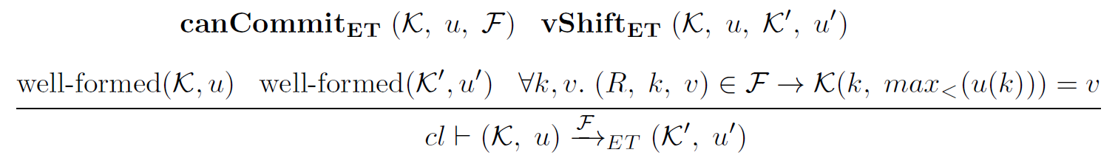
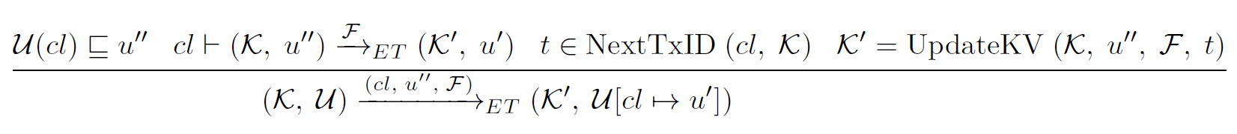
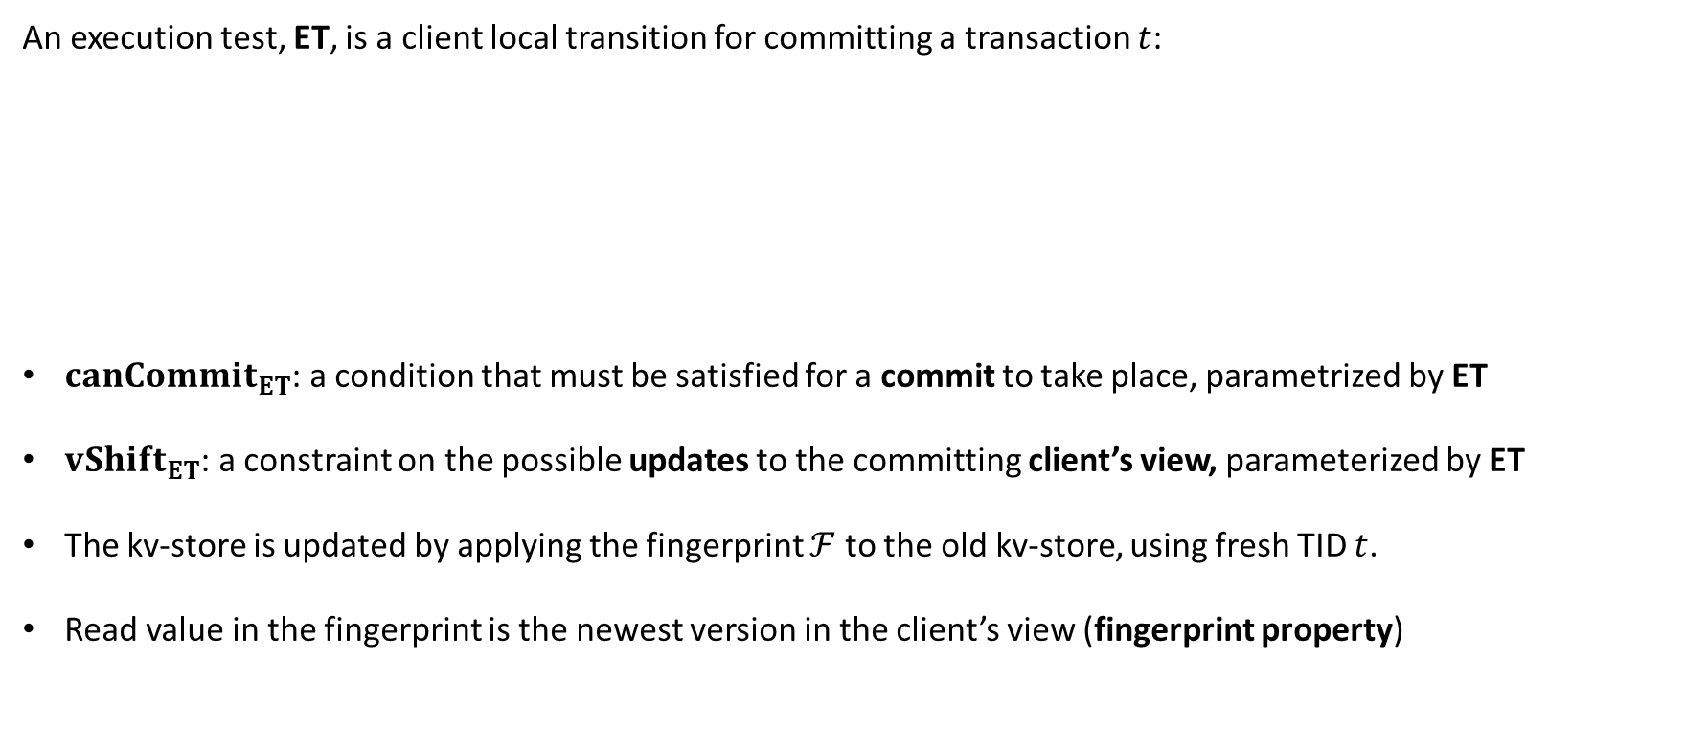
Execution Tests
An execution test, ET, is a client local transition for committing a transaction $t$:
$canCommit_{ET}$: a condition that must be satisfied for a commit to take place, parametrized by ET
$vShift_{ET}$: a constraint on the possible updates to the committing client’s view, parameterized by ET
The kv-store is updated by applying the fingerprint $ℱ$ to the old kv-store, using fresh TID $t$.
Read value in the fingerprint is the newest version in the client’s view (fingerprint property)
Notes:
Fingerprint property = last-write-wins policy in fingerprints
When the conditions hold, the associated update (commit) is allowed under the given consistency model ET.

Slide 12
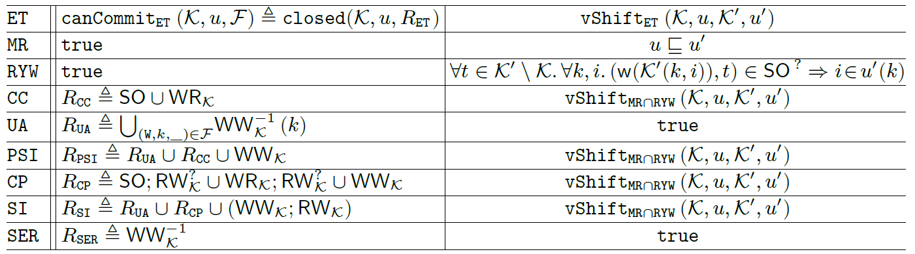

Execution Tests
Set of visible transactions for a client with view $u$ in the key-value store $𝒦$:
$visTx\left(𝒦,u\right)=\{v_writer(𝒦(k, i)) |$ $i∈u(k)\}$
$canCommit_{ET}\left(𝒦,u,ℱ\right)$ is defined as a view closure for $u$ with respect to $𝒦$, and a relation $R_{ET}$
$≜closed\left(𝒦,u,R_{ET}\right)$ and it holds if and only if: $visTx\left(𝒦,u\right)={\left(R_{ET}^{∗}\right)}^{−1}(visTx(𝒦,u))\backslash ($read-only txns$)$
Xiong et al.[10] – Figure 6

Slide 13
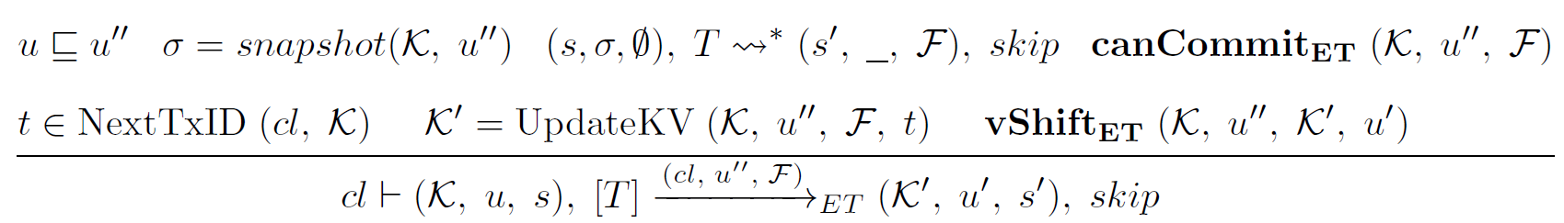


Programming language
Transition rule for an atomic transaction $[T]$:
For modeling client programs, in addition to the abstract model state (configuration), we need client-local stacks for storing values in variables and expression evaluations.
A more concrete model of the execution test, including how the fingerprint $ℱ$ is built by the client’s program.
We proved that the programming language model refines the abstract execution test model.
This implies property preservation, so the well-formedness of the key-value stores and client views is preserved for the programming language model.
: Transactional multi-step
Implies that $ℱ$ has the fingerprint property
Notes:
For non-primitive transactions and commands, the complete list of all transition rules, such as standard compound constructs' processing steps, have been discussed in detail in Xiong’s PhD Thesis [15]. We have modeled these transition rules as command/transaction steps in the programming language model in Isabelle/HOL.

Slide 14
Protocol verification by refinement
Many different concurrency control mechanisms in distributed systems protocols
RAMP protocol [1] RA
COPS protocol [6] CC
Eiger-PORT [10] CC
Two-Phase Locking SER
The complex concurrent behaviors of these protocols call for formal verification
To verify if the protocol satisfies the desired consistency model
Idea: Verifying database concurrency control protocols by proving that they refine the formalized execution test of the desired consistency model.
satisfies
satisfies
satisfies
Modeled in Isabelle/HOL, refinement proof in progress
satisfies
Modeled and proven in the Isabelle/HOL framework

Slide 15
Protocol verification by refinement
Refinement guarantees trace inclusion, hence property preservation.
If a protocol refines a consistency model execution test, it preserves its consistency guarantees
➔ satisfies the consistency model
Protocol verification by refinement consists of two steps:
modeling the protocol as an event system.
proving that the modeled protocol refines the execution test of the desired consistency model.
For the refinement proof of each protocol the following must be done:
The abstract state is reconstructed from the concrete state.
Prove that the events that refine skip of the abstract model do not change the state.
For the events refining the abstract commit (execution test transition rule) all the ET rule premises are satisfied by the reconstructed abstract state (5 conditions + 3 view well-formedness)

Slide 16
1st protocol verification
2PL + 2PC satisfying serializability

Slide 17
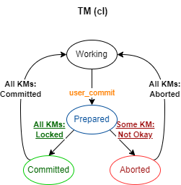
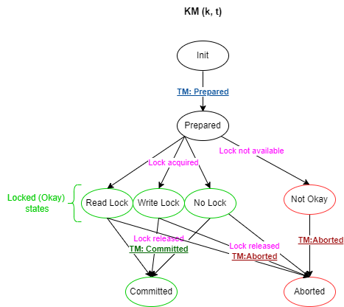
2PL + 2PC protocol
The two-phase locking (2PL) protocol works on top of a two-phase commit (2PC) protocol.
Each resource manager is responsible for one key ➔ Key Manager (KM)
Transaction Manager
TM state
One for each client.
Status Sequence Number (last sqn of client) View (of client on the kv-store)
Key Manager
KM state
One for each key and transaction pair.
Status Local Key Version List Local Key Fingerprint
Notes:
The arrows by transition relation in isabelle and defining these events

Slide 18
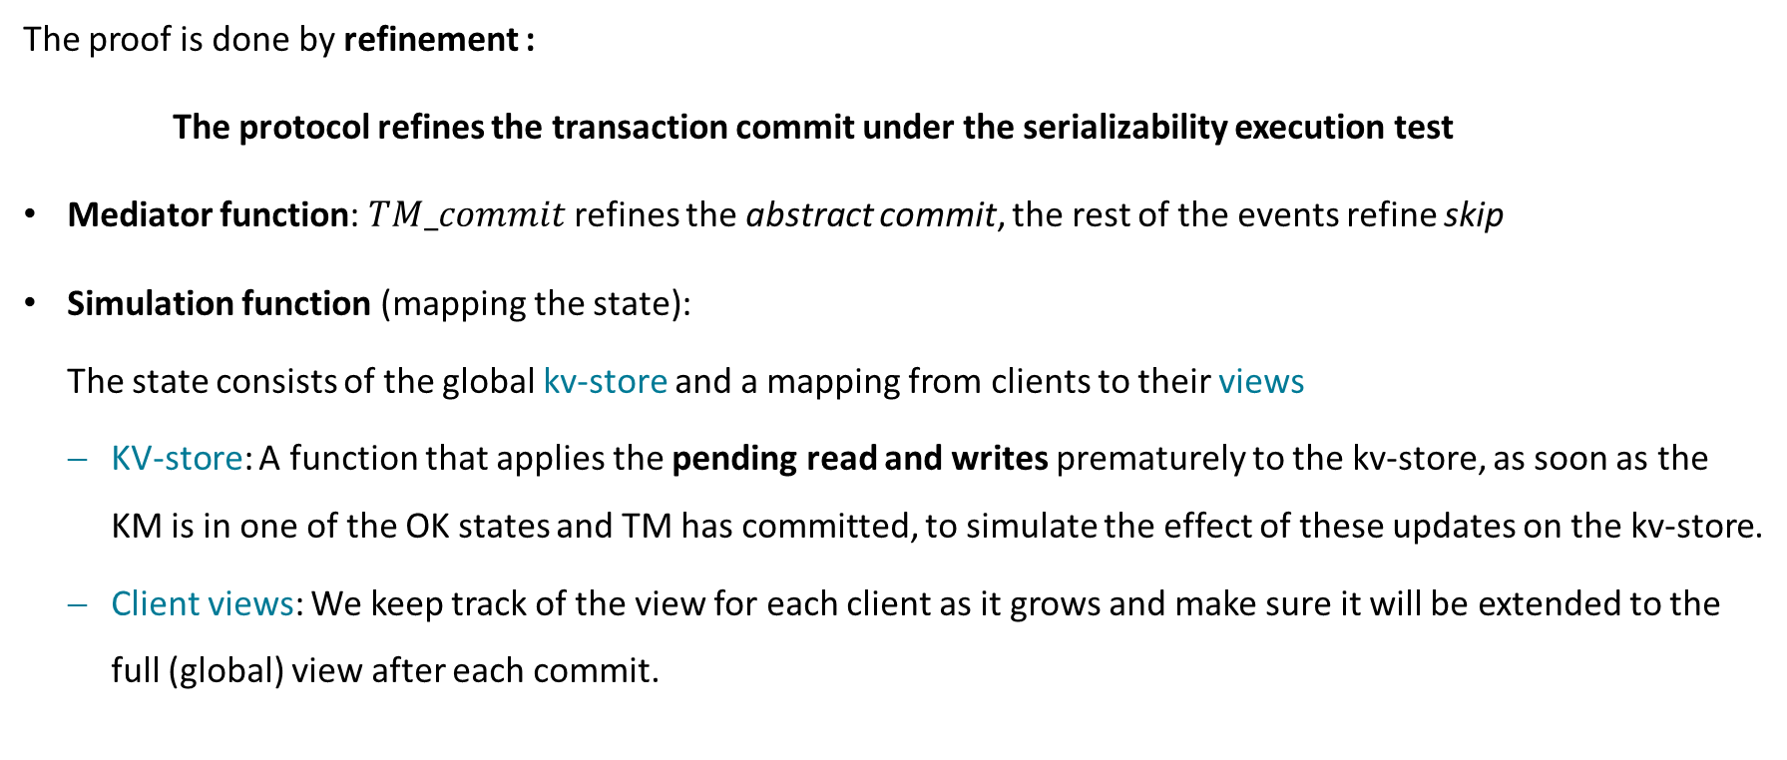
Verifying 2PL + 2PC protocol satisfying SER
The proof is done by refinement :
The protocol refines the transaction commit under the serializability execution test
Mediator function: $TM_commit$ refines the abstract commit, the rest of the events refine skip
Simulation function (mapping the state):
The state consists of the global kv-store and a mapping from clients to their views
KV-store: A function that applies the pending read and writes prematurely to the kv-store, as soon as the KM is in one of the OK states and TM has committed, to simulate the effect of these updates on the kv-store.
Client views: We keep track of the view for each client as it grows and make sure it will be extended to the full (global) view after each commit.

Slide 19
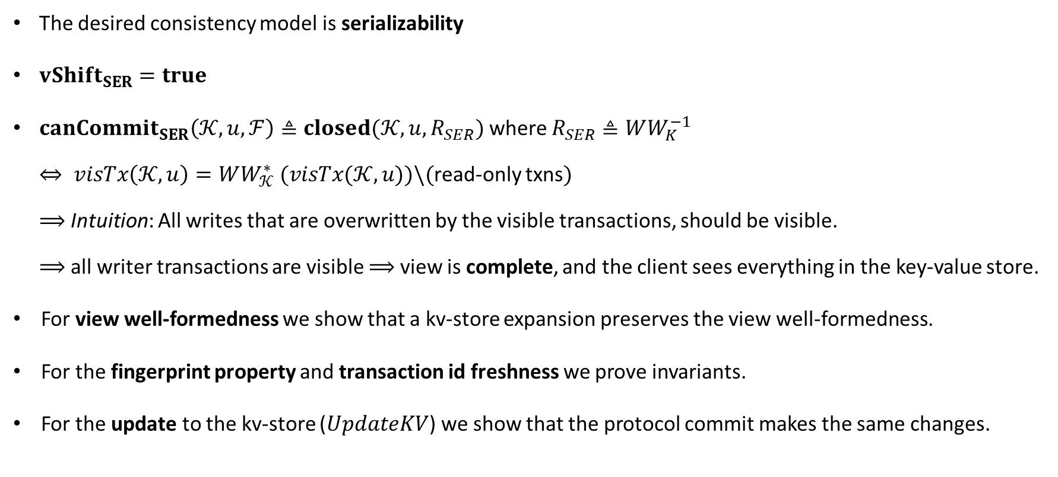
Proof obligations
The desired consistency model is serializability
$vShift_{SER}=true$
${canCommit}_{SER}\left(𝒦,u,ℱ\right)≜closed(𝒦,u,R_{SER})$ where $R_{SER}≜WW_{K}^{−1}$
$⇔ visTx\left(𝒦,u\right)=WW_{𝒦}^{∗} (visTx(𝒦,u))\backslash ($read-only txns$)$
$⟹$Intuition: All writes that are overwritten by the visible transactions, should be visible.
$⟹$all writer transactions are visible $⟹$ view is complete, and the client sees everything in the key-value store.
For view well-formedness we show that a kv-store expansion preserves the view well-formedness.
For the fingerprint property and transaction id freshness we prove invariants.
For the update to the kv-store ($UpdateKV$) we show that the protocol commit makes the same changes.

Slide 20
2nd protocol verification
Eiger-PORT+ satisfying causal+ consistency

Slide 21
The Eiger-PORT protocol
The Eiger-PORT protocol is a performance-optimized version of an older protocol Eiger [22], that supports read-only and write-only transactions.
Eiger uses Lamport clocks [17] to assign a timestamp to each committed write.
Lamport clocks can create a partial order on events (used to capture causality relations).
Write-only transactions in Eiger follow a variation of the 2PC protocol that always commits.
Read-only transactions are optimized in Eiger-PORT to be non-blocking, need one round of communication, and have constant metadata.
Eiger-PORT must also satisfy Read Your Writes (RYW) and Read atomicity (RA) as they are weaker than CC.
Notes:
Readerset: added to original Eiger-PORT to capture read registration of the abstract model

Slide 22
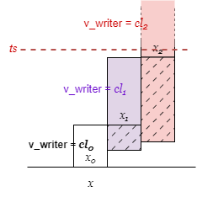
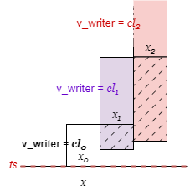
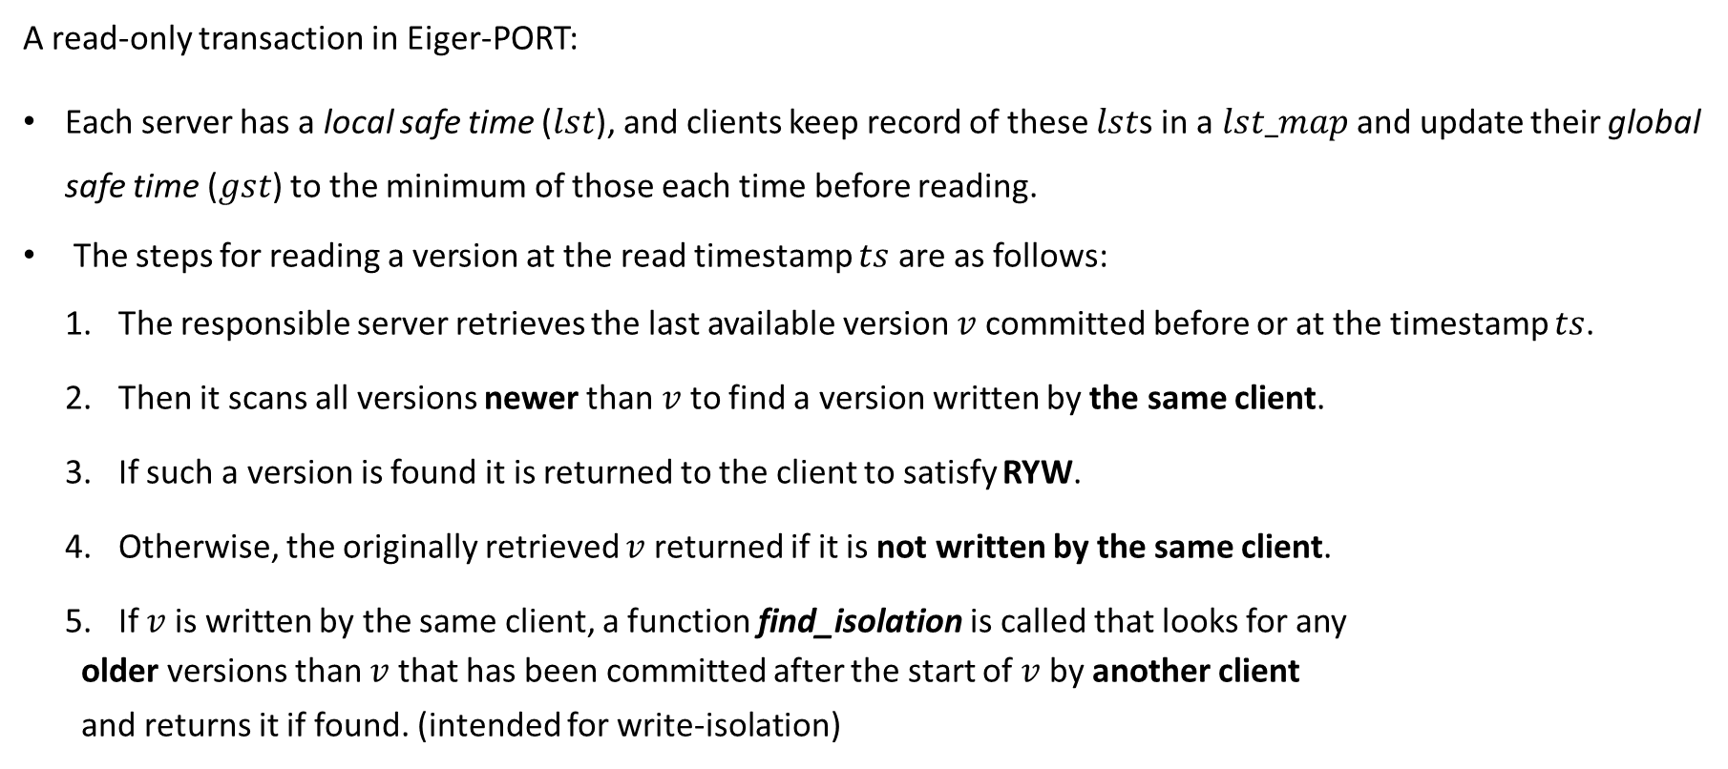


The Eiger-PORT protocol
A read-only transaction in Eiger-PORT:
Each server has a local safe time ($lst$), and clients keep record of these $lst$s in a $lst_map$ and update their global safe time ($gst$) to the minimum of those each time before reading.
The steps for reading a version at the read timestamp $ts$ are as follows:
The responsible server retrieves the last available version $v$committed before or at the timestamp $ts$.
Then it scans all versions newer than $v$ to find a version written by the same client.
If such a version is found it is returned to the client to satisfy RYW.
Otherwise, the originally retrieved $v$ returned if it is not written by the same client.
If $v$ is written by the same client, a function find_isolation is called that looks for any
older versions than $v$ that has been committed after the start of $v$ by another client
and returns it if found. (intended for write-isolation)
$$v$$
$$v$$

Slide 23
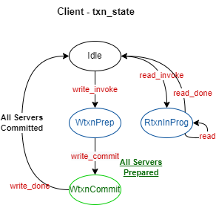
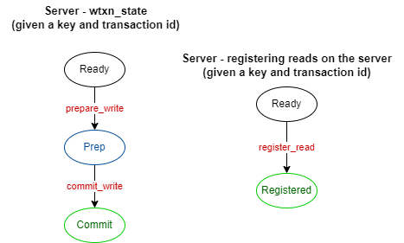
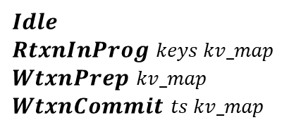
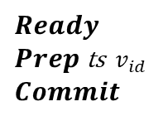
The Eiger-PORT protocol
The global state consists of the client state and the server state: (transition labels are events)
Client state:
txn_state
txn_sn
gst
lst_map
cl_view
One for each client.
Server state:
wtxn_state
clock
lst
pending_wtxns
DS
One for each server(key) and transaction id pair.
$$Idle$$ $RtxnInProg$ $keys kv_map$ $WtxnPrep$ $kv_map$ $WtxnCommit$ $ts kv_map$
$$Ready$$ $Prep$ ts$v_{id}$ $$Commit$$
Not modeled by a state variable, but by a search on the kv-store

Slide 24
Protocol formalization overview
We noticed that Xiong et al.[10] framework implicitly assumes a total order on non-causally-ordered writes to a key, by having fixed version indices (identifiers) that denote order.
All clients see the versions of a key’s version list in the same order ➔ stronger than CC.
This is called causal+ consistency (CC+) or causal convergence (CCv) in the literature.
It is the de facto of production CC database systems, e.g., used in Cure [23] and MongoDB [24].
The Eiger-PORT protocol [7] satisfies plain CC, so we optimized it to satisfy CC+ instead.
The optimization is also expected to improve performance by removing the usage of the find_isolation function.
This optimization does not break write isolation and preserves atomic visibility.

Slide 25
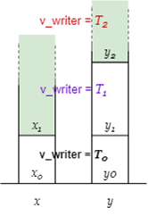
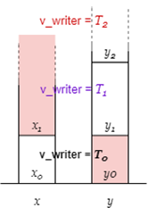
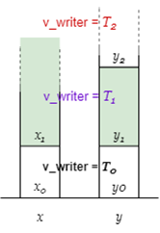
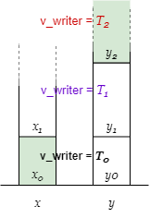
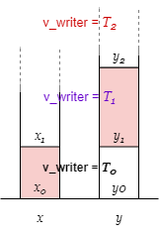
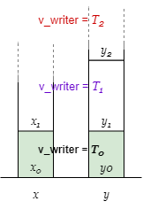
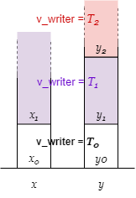

Fractured reads and atomic visibility
Let us review the definition of atomic visibility based on the anomaly it avoids: (taken from [1])
Fractured Reads: A transaction $T_{j}$ exhibits the fractured reads phenomenon, if transaction $T_{i}$ writes versions $x_{a}$ of $x$ and $y_{b}$ of $y$, $T_{j}$ reads version $x_{a}$ of $x$ and version $y_{c}$ of $y$, and $c<b$ ($y_{c}$ is older than $y_{b}$).
For example, for two objects $x$ and $y$, if $T_{0}$ writes $x_{0}$ and $y_{0}$, $T_{1}$ writes $x_{1}$ and $y_{1}$, and $T_{2}$ writes only $y_{2}$:
$\left(x_{0},y_{0}\right)$ is not a fractured read
$\left(x_{0},y_{1}\right)$ is a fractured read
$\left(x_{0},y_{2}\right)$ is not a fractured read
$\left(x_{1},y_{0}\right)$ is a fractured read
$\left(x_{1},y_{1}\right)$ is not a fractured read
$\left(x_{1},y_{2}\right)$ is not a fractured read

Slide 26
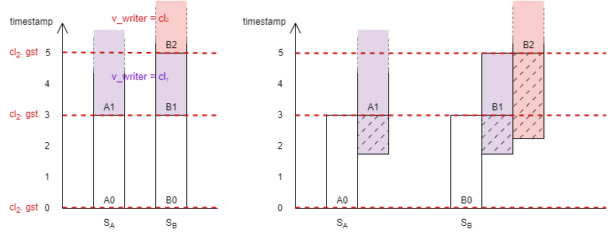

Example
Two servers $S_{A}$ and $S_{B}$ each responsible for one key: $A$ and $B$

Slide 27
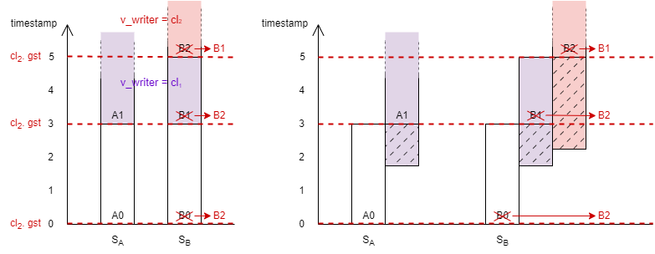

Eiger-PORT, client ${cl}_{2}$'s perspective of the example
Order of versions for client $cl_{1}:B0→B1→B2$, for client $cl_{2}:B0→B2→B1$.

Slide 28
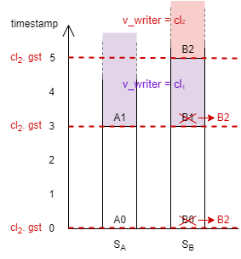

Eiger-PORT+, client ${cl}_{2}$'s perspective of the example
Order of versions for client $cl_{1}:B0→B1→B2$, for client $cl_{2}:B0→B2$.

Slide 29
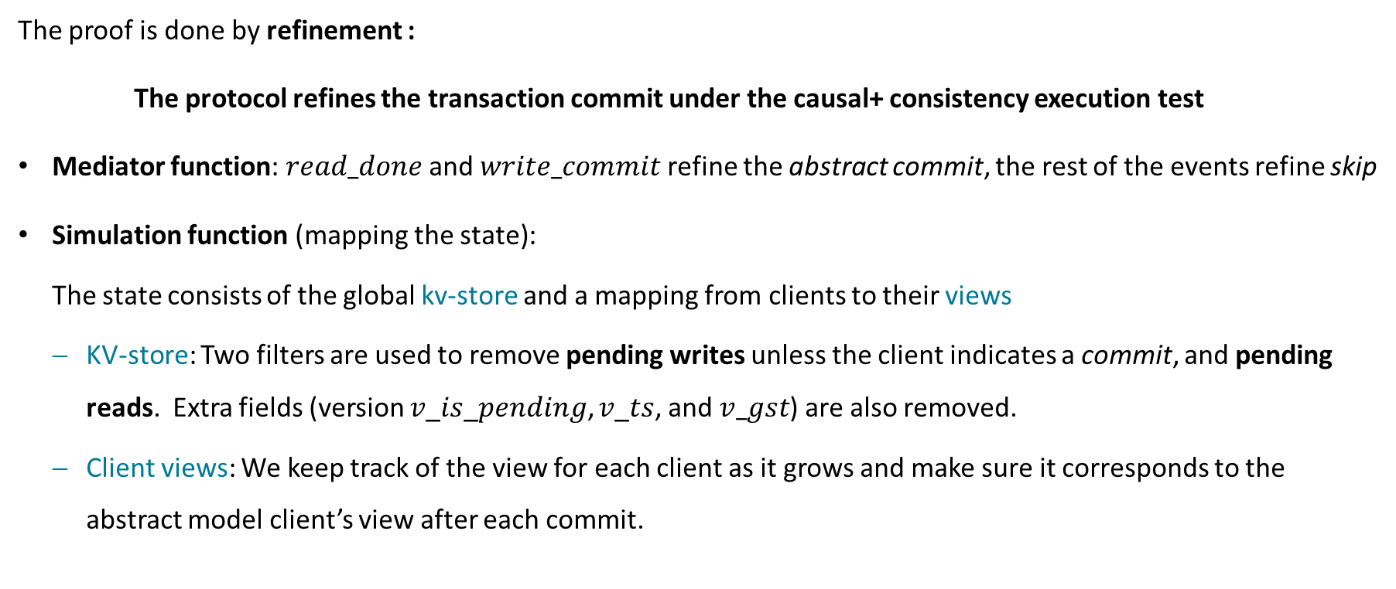
Verifying Eiger-PORT+ protocol satisfying CC+
The proof is done by refinement :
The protocol refines the transaction commit under the causal+ consistency execution test
Mediator function: $read_done$ and $write_commit$ refine the abstract commit, the rest of the events refine skip
Simulation function (mapping the state):
The state consists of the global kv-store and a mapping from clients to their views
KV-store: Two filters are used to remove pending writes unless the client indicates a commit, and pending reads. Extra fields (version 𝑣_𝑖𝑠_𝑝𝑒𝑛𝑑𝑖𝑛𝑔, 𝑣_𝑡𝑠, and $v_gst$) are also removed.
Client views: We keep track of the view for each client as it grows and make sure it corresponds to the abstract model client’s view after each commit.

Slide 30
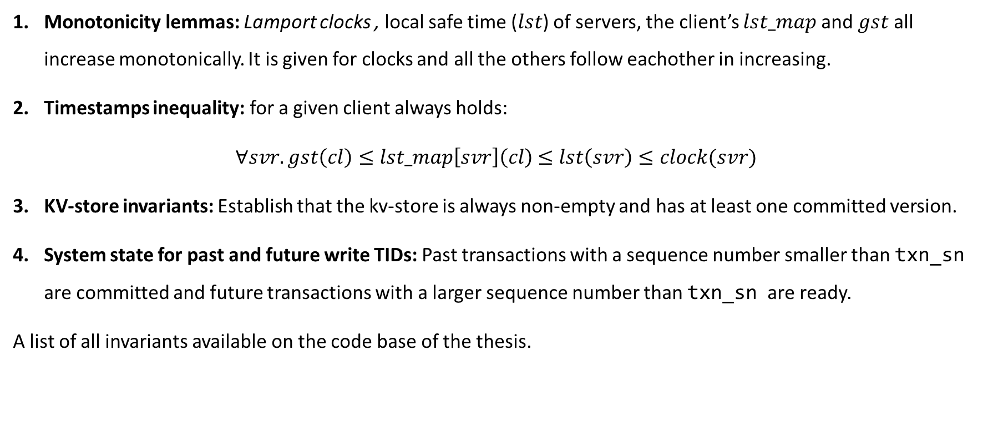
Invariants for the refinement proof
Monotonicity lemmas: Lamport clocks , local safe time ($lst$) of servers, the client’s $lst_map$ and $gst$ all increase monotonically. It is given for clocks and all the others follow eachother in increasing.
Timestamps inequality: for a given client always holds:
$∀svr. gst\left(cl\right)≤lst_map\left[svr\right]\left(cl\right)$ $≤lst\left(svr\right)≤clock(svr)$
KV-store invariants: Establish that the kv-store is always non-empty and has at least one committed version.
System state for past and future write TIDs: Past transactions with a sequence number smaller than txn_sn are committed and future transactions with a larger sequence number than txn_sn are ready.
A list of all invariants available on the code base of the thesis.

Slide 31
Conclusions

Slide 32
Conclusion
Contributions
Formalizing a general framework of consistency models
Proving the assumptions of the framework as invariants in our model
Using the framework for protocol verification: The first general and fully mechanized correctness proof of a concurrency control protocol in such a framework
Verification of Two-Phase Locking + Two-Phase Commit protocol satisfying Serializability
Formalizing a candidate state-of-the-art protocol which is the representative implementation of its consistency model (Eiger-PORT for CC)
Optimizing the protocol (Eiger-PORT+) to satisfy a stronger consistency model CC+

Slide 33
Conclusion
Future Work
Finishing the verification proof of the optimized Eiger-PORT+ protocol and analyzing the resulting performance improvement
Developing a stronger and more generic operational framework of consistency models by relaxing some restrictions established by the framework of Xiong et al.[10], for example, by:
Relaxing the snapshot property to deal with:
Weaker consistency models: Monotonic Atomic View (MAV) and Read Committed (RC)
Recent transaction algorithms which allow reads to fetch prepared-only versions: RAMP or LORA
Relaxing the last-write-wins policy, to handle algorithms like RAMP-1PW.
Refining the operational framework of consistency models to achieve a more generic (parameterized) distributed model.
Continuing the refinement of the protocols in order to connect it to the Igloo framework and get further refinements into Igloo I/O specifications.

Slide 34
Thank you for your attention!
Questions?

Slide 35
References
[1] P. Bailis, A. Fekete, A. Ghodsi, J. M. Hellerstein, and I. Stoica, "Scalable atomic visibility with ramp transactions," ACM Transactions on Database Systems (TODS), vol. 41, no. 3, pp. 1-45, 2016.
[2] W. Lloyd, M. J. Freedman, M. Kaminsky, and D. G. Andersen, "Don't settle for eventual: Scalable causal consistency for wide-area storage with COPS," in Proceedings of the Twenty-Third ACM Symposium on Operating Systems Principles, 2011, pp. 401-416.
[3] Y. Sovran, R. Power, M. K. Aguilera, and J. Li, "Transactional storage for geo-replicated systems," in Proceedings of the Twenty-Third ACM Symposium on Operating Systems Principles, 2011, pp. 385-400.
[4] H. Berenson, P. Bernstein, J. Gray, J. Melton, E. O'Neil, and P. O'Neil, "A critique of ANSI SQL isolation levels," ACM SIGMOD Record, vol. 24, no. 2, pp. 1-10, 1995.
[5] C. H. Papadimitriou, "The serializability of concurrent database updates," Journal of the ACM (JACM), vol. 26, no. 4, pp. 631-653, 1979.
[6] R. Rajan, J. Boyle, A. Sastry, R. Cohen, D. Durham, and S. Herzog, "The COPS (Common Open Policy Service) Protocol," RFC 2748, Jan. 2000. [Online]. Available: https://www.rfc-editor.org/info/rfc2748
[7] H. Lu, S. Sen, and W. Lloyd, "Performance-Optimal Read-Only transactions,” in 14th USENIX Symposium on Operating Systems Design and Implementation (OSDI 20). USENIX Association, Nov. 2020, pp. 333-349. [Online]. Available: https://www.usenix.org/conference/osdi20/presentation/lu
[8] A. Adya, "Weak consistency: a generalized theory and optimistic implementations for distributed transactions," Ph.D. dissertation, Massachusetts Institute of Technology, Department of Electrical Engineering and Computer Science, 1999.

Slide 36
References
[9] A. Cerone, G. Bernardi, and A. Gotsman, "A framework for transactional consistency models with atomic visibility," in 26th International Conference on Concurrency Theory, CONCUR 2015, Madrid, Spain, September 1.4, 2015, ser. LIPIcs, L. Aceto and D. de Frutos-Escrig, Eds., vol. 42. Schloss Dagstuhl - Leibniz-Zentrum für Informatik, 2015, pp. 58-71. [Online]. Available: https://doi.org/10.4230/LIPIcs.CONCUR.2015.58
[10] S. Xiong, A. Cerone, A. Raad, and P. Gardner, "Data consistency in transactional storage systems: A centralised semantics," in 34th European Conference on Object-Oriented Programming, ECOOP 2020, November 15-17, 2020, Berlin, Germany (Virtual Conference), ser. LIPIcs, R. Hirschfeld and T. Pape, Eds., vol. 166. Schloss Dagstuhl - Leibniz-Zentrum für Informatik, 2020, pp. 21:1-21:31. [Online]. Available: https://doi.org/10.4230/LIPIcs.ECOOP.2020.21
[11] C. Sprenger, T. Klenze, M. Eilers, F. Wolf, P. Müller, M. Clochard, and D. Basin, "Igloo: Soundly linking compositional refinement and separation logic for distributed systems verification," in ACM Program. Lang. 4, OOPSLA, Article 152, 2020. [Online]. Available: https://doi.org/10.1145/3428220
[12] S. Gilbert and N. Lynch, "Brewer's conjecture and the feasibility of consistent, available, partition-tolerant web services," ACM Sigact News, vol. 33, no. 2, pp. 51-59, 2002.
[13] P. Bailis, A. Davidson, A. Fekete, A. Ghodsi, J. M. Hellerstein, and I. Stoica, "Highly available transactions: Virtues and limitations," Proc. VLDB Endow., vol. 7, no. 3, p. 181-192, nov 2013. [Online]. Available: https://doi.org/10.14778/2732232.2732237
[14] ANSI X3.135-1992, American National Standard for Information Systems -- Database Language -- SQL (includes ANSI X3.168-1989). November, 1992.
[15] S. Xiong, "Parametric operational semantics for consistency models," Ph.D. dissertation, Imperial College London, 2019.

Slide 37
References
[16] M. Van Steen and A. S. Tanenbaum, Distributed systems. Maarten van Steen Leiden, The Netherlands, 2017.
[17] L. Lamport, "Time, clocks, and the ordering of events in a distributed system,"Commun. ACM, vol. 21, no. 7, p. 558-565, jul 1978. [Online]. Available: https: //doi.org/10.1145/359545.359563
[18] B. Liskov and R. Ladin, "Highly available distributed services and fault-tolerant distributed garbage collection," in Proceedings of the fifth annual ACM symposium on Principles of distributed computing, 1986, pp. 29-39.
[19] T. Nipkow, M. Wenzel, and L. C. Paulson, Eds., Isabelle/HOL - A Proof Assistant for Higher-Order Logic. Springer Berlin Heidelberg, 2002. [Online]. Available: https://doi.org/10.1007%2F3-540-45949-9
[20] T. Nipkow and G. Klein, Concrete semantics: with Isabelle/HOL. Springer, 2014. [Online]. Available: https://doi.org/10.1007%2F978-3-319-10542-0
[21] E. W. Weisstein, "invariant." from mathworld-a wolfram web resource," https://mathworld.wolfram.com/Invariant.html.
[22] W. Lloyd, M. J. Freedman, M. Kaminsky, and D. G. Andersen, "Stronger semantics for Low-Latency Geo-Replicated storage," in 10th USENIX Symposium on Networked Systems Design and Implementation (NSDI 13). Lombard, IL: USENIX Association, Apr. 2013, pp. 313-328. [Online]. Available: https://www.usenix.org/conference/nsdi13/technical-sessions/presentation/lloyd
[23] D. D. Akkoorath, A. Z. Tomsic, M. Bravo, Z. Li, T. Crain, A. Bieniusa, N. Preguica, and M. Shapiro, "Cure: Strong semantics meets high availability and low latency," in 2016 IEEE 36th International Conference on Distributed Computing Systems (ICDCS). IEEE, 2016, pp. 405-414.
[24] H. Ouyang, H. Wei, and Y. Huang, "Checking causal consistency of mongodb," in Proceedings of the 12th Asia-Pacific Symposium on Internetware, 2020, pp. 209-216.

Slide 38
References
[25] P. S. Group, "Eiger-port," https://github.com/princeton-sns/Eiger-PORT, 2020.
[26] S. Burckhardt, D. Leijen, M. Fähndrich, and M. Sagiv, "Eventually consistent transactions,” in Programming Languages and Systems, H. Seidl, Ed. Berlin, Heidelberg: Springer Berlin Heidelberg, 2012, pp. 67-86.
[27] P. A. Bernstein and N. Goodman, "Concurrency control in distributed database systems,“ ACM Computing Surveys (CSUR), vol. 13, no. 2, pp. 185-221, 1981.
[28] A. Cerone, A. Gotsman, and H. Yang, "Algebraic Laws for Weak Consistency," in 28th International Conference on Concurrency Theory (CONCUR 2017), ser. Leibniz International Proceedings in Informatics (LIPIcs), R. Meyer and U. Nestmann, Eds., vol. 85. Dagstuhl, Germany: Schloss Dagstuhl-Leibniz-Zentrum fuer Informatik, 2017, pp. 26:1-26:18. [Online]. Available: http://drops.dagstuhl.de/opus/volltexte/2017/779447
[29] N. Crooks, Y. Pu, L. Alvisi, and A. Clement, "Seeing is believing: A client-centric specification of database isolation," in Proceedings of the ACM Symposium on Principles of Distributed Computing, ser. PODC '17. New York, NY, USA: Association for Computing Machinery, 2017, p. 73-82. [Online]. Available: https://doi.org/10.1145/3087801.3087802
[30] G. Kaki, K. Nagar, M. Najafzadeh, and S. Jagannathan, "Alone together: Compositional reasoning and inference for weak isolation," Proc. ACM Program. Lang., vol. 2, no. POPL, dec 2017. [Online]. Available: https://doi.org/10.1145/3158115
[31] K. Nagar and S. Jagannathan, "Automated Detection of Serializability Violations Under Weak Consistency," in 29th International Conference on Concurrency Theory (CONCUR 2018), ser. Leibniz International Proceedings in Informatics (LIPIcs), S. Schewe and L. Zhang, Eds., vol. 118. Dagstuhl, Germany: Schloss Dagstuhl-Leibniz-Zentrum fuer Informatik, 2018, pp. 41:1-41:18. [Online]. Available: http://drops.dagstuhl.de/opus/volltexte/2018/9579

Slide 39
References
[32] S. Liu, P. C. Ölveczky, M. Zhang, Q. Wang, and J. Meseguer, "Automatic analysis of consistency properties of distributed transaction systems in maude," in Tools and Algorithms for the Construction and Analysis of Systems, T. Vojnar and L. Zhang, Eds. Cham: Springer International Publishing, 2019, pp. 40-57.
[33] S. Liu, "All in one: Design, verification, and implementation of snow-optimal read atomic transactions," ACM Transactions on Software Engineering and Methodology (TOSEM), vol. 31, no. 3, pp. 1-44, 2022.

Slide 40
Shabnam Ghasemirad
Information Security Group
sghasemirad@student.ethz.ch
Mechanized Data Consistency Models for Distributed Database Transactions
Supervisors:
Dr. Christoph Sprenger
Dr. Si Liu
Professor:
Prof. Dr. David Basin
ETH Zürich

